Slide 1

Agile Performance Monitoring
& Continuous Improvement
Shifting the focus from “did you hit this goal or KPI” to “how do we support you in getting to the next goal” through Continuous Improvement Strategies

Slide 2
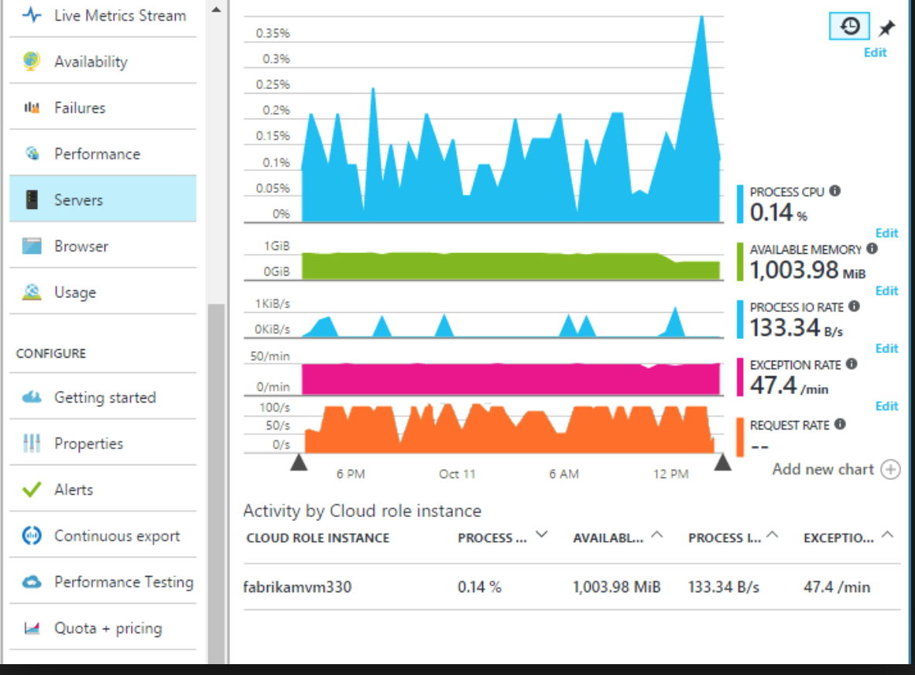
What is Performance Monitoring & Management?
Context
Monitoring Performance against a predetermined goal
Determining if an threshold has been met or exceeded
Working within expected guidelines
Evaluating if someone or something is good enough
Delivering to Key Performance Indicators (KPI)
Exceeding expectations…
Performance Management is often a source of great frustration for employees who do not clearly understand their goals or what is expected of them at work.: (5 Ways to transform the annual performance review‘, Halogen Software)

Slide 3
We’ve tasked our teams to be Agile: highly autonomous and dynamic in delivery…
Context
Organizations don’t remain static.
Political, economic and market changes can cause a business to change direction at any movement.
That’s before we even consider internal changes including appointments, new products and many more.
Given the time between setting goals and then evaluating their success,
do we really expect periodic objectives for employees to be effective?

Slide 4
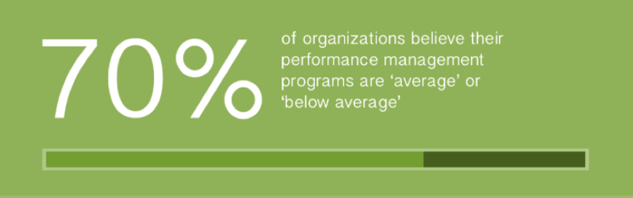
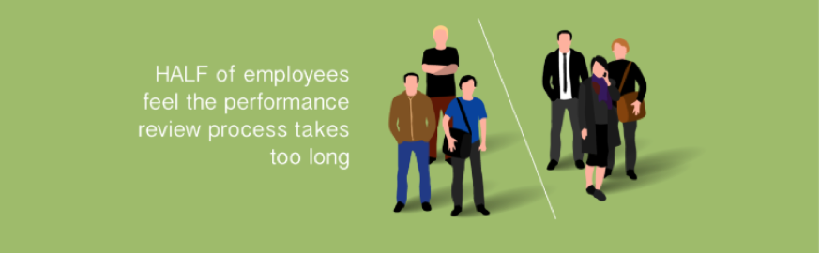
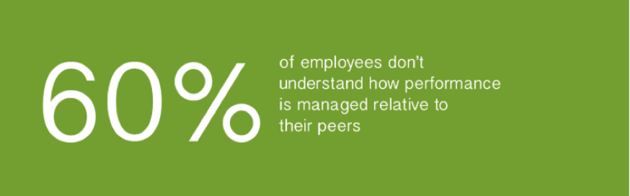
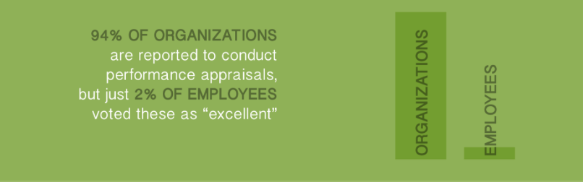
Performance Management?
Background
In a fast-paced digital age individuals are accustomed to communicating in real time & employees increasingly expect conversations to be instantaneous.
The resulting shift away from traditional annual reviews or formal performance management processes is setting new expectations for organizations.
Research results from Brandon Hall Group’s 2015 survey

Slide 5
The Alternative
Introducing:
Research results from Brandon Hall Group’s 2015 survey show 70% of organizations believe
their performance management programs are ‘average’ or ‘below average’….
Hailed as the successor to the structured annual performance review,
Agile Performance Management
[has been] coined ‘the future of performance management’
by McKinsey, pwc, Harvard Business Review.

Slide 6
Why Agile Performance Management?
Market Trend
The reason for the shift lies in the growth of technology.
The workplace is more collaborative, social and fast-paced; we’re communicating in real time and expecting the same of our conversations with managers.
Tech companies have unsurprisingly led from the front, with early adopters including:
  Microsoft (which abolished its employee evaluation system way back in 2013)
  Netflix (which turned its back on annual objectives)
  Adobe (who pioneered a ‘check-in’ system as an alternative)

Slide 7
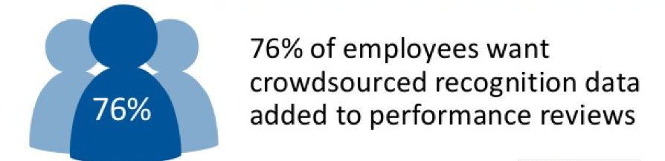
Agile Performance Management
Managers are commonly cited as the primary reason why employee chose to leave their jobs!
When establishing Agile Performance Management:
Review frequently
Negotiate objectives and expectation (employees at all levels, not just middle management & above)
Establish feedback loops via crowdsourcing
Enabling individuals to give and receive recognition freely is fundamental to successful Agile Performance Management
Agile Performance Management focuses on people as much as the end goals, striving for continuous improvement and real time understanding of employee opinions, issues or concerns.

Slide 8
Foster a culture of Continuous Innovation and Improvement
Start with Continuous Improvement
Empower employees by communicating your organization’s values, vision and mission. Adopt a policy of transparency to communicate what you do: the challenges, the events, the achievements.
Ensure recognition is given to [individuals] that contributed to the achievement.
When employees can recognize and receive feedback on the part they’ve had to play, it has measurable impact on engagement levels, productivity and bottom line outcomes.
ROI is not always the result – we learn through experimentation
(Amazon reject over 70% of their own innovations & ideas!)

Slide 9
Agile Performance Monitoring
Monitor & Coach
The concept is pretty simple – and far from new…
It focus’ on 3 key, core elements:
Frequent feedback, rather than bi-annual/annual structured reviews
Regular conversations, check-ins and flexibility, rather than annual objectives or formal arranged meetings
Coaching conversations and a focus on growth and development, rather than on delivery against objectives
Continuous Improvements is a mechanism that uses feedback to encourages improvements in a dynamic, incremental, sustainable and visible fashion.

Slide 10
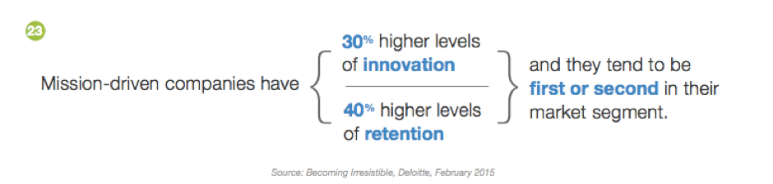
Continuous Improvement + Agile Performance Monitoring
= Performance Management
But Why?
Continuous Innovation and Improvements are strategic approaches that keeps up with business changes and trends, while empowering employees through two-way regular feedback and conversations.
The business benefits include:
  increased productivity
  higher retention rates
  improved engagement & bottom-line profitability
Agile Performance Management is having a tangible mechanism to understand and trace Continuous Improvements, its not about Hierarchy or Control Mechanisms.
Agile Performance Monitoring should be a flexible mechanism that support experiments,
providing a safe place to test, learn and fail.

Slide 11
It’s all about dynamics / and encouraging / fostering!
Summary
Transparency
Trust and Autonomy
Safe environment to experiment
ROI is important but not the only factor
Continuous Improvements are actually more important!
I have an idea… what’s stopping me – Performance Monitoring?!?!

